Slide 1
Eagle Mountain-Saginaw
Independent
School District
1Q23
Demographic Report

Slide 2
Local Economic Conditions

Slide 3
DFW New Home Starts & Closings
Key Trends
Starts: -23% YOY / -8% QOQ
Closings: +5% YOY / +1% QOQ
Closings Exceed Starts by 5,455 Homes
Source: Zonda

Slide 4
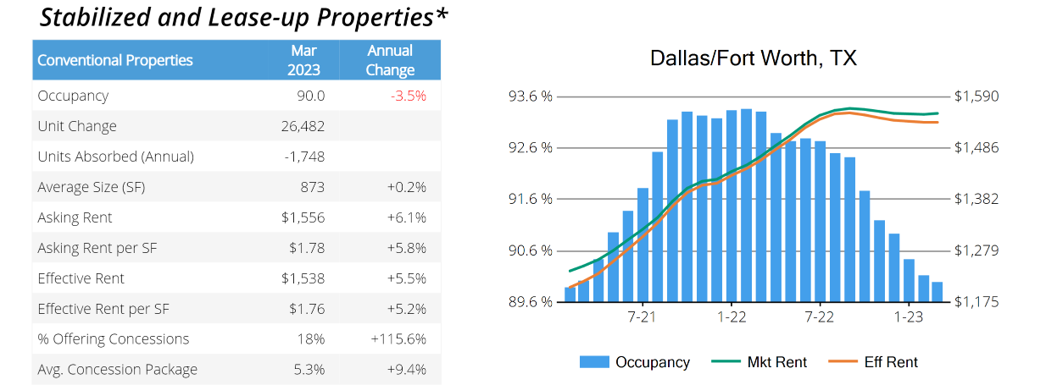
Housing Market Trends: Multi-family Market- March 2023

Slide 5
DFW New Home Ranking Report ISD Ranked by Annual Closings – 1Q23
Rank | District Name | Annual Starts | Annual Closings | Inventory | VDL | Future
1 | NORTHWEST ISD | 2,763 | 3,529 | 1,675 | 5,254 | 39,591
2 | DENTON ISD | 2,129 | 2,828 | 1,580 | 4,345 | 28,200
3 | PROSPER ISD | 2,476 | 2,620 | 1,877 | 3,228 | 19,136
4 | PRINCETON ISD | 2,033 | 2,104 | 1,026 | 2,472 | 8,904
5 | FORNEY ISD | 1,225 | 1,917 | 810 | 4,434 | 19,895
6 | ROYSE CITY ISD | 1,322 | 1,608 | 717 | 1,850 | 8,446
7 | FRISCO ISD | 1,004 | 1,553 | 689 | 1,906 | 9,134
8 | CRANDALL ISD | 1,382 | 1,497 | 406 | 1,253 | 18,282
9 | DALLAS ISD | 1,792 | 1,415 | 1,953 | 1,813 | 6,237
10 | AUBREY ISD | 985 | 1,343 | 452 | 1,586 | 5,113
11 | EAGLE MT-SAGINAW ISD | 1,707 | 1,278 | 1,081 | 2,868 | 16,844
12 | ROCKWALL ISD | 1,201 | 1,240 | 992 | 3,277 | 11,008
13 | LEWISVILLE ISD | 1,025 | 1,206 | 771 | 752 | 1,583
14 | MCKINNEY ISD | 1,379 | 1,138 | 1,112 | 1,880 | 15,434
15 | CELINA ISD | 795 | 1,109 | 598 | 2,544 | 36,222
16 | CROWLEY ISD | 1,187 | 1,093 | 804 | 2,370 | 15,659
17 | MANSFIELD ISD | 992 | 1,083 | 868 | 1,653 | 6,475
18 | MIDLOTHIAN ISD | 565 | 1,083 | 508 | 2,840 | 18,904
19 | ANNA ISD | 924 | 1,076 | 488 | 1,419 | 7,328
20 | COMMUNITY ISD | 582 | 1,062 | 383 | 1,623 | 7,147
* Based on additional Zonda Education housing research

Slide 6
District New Home Starts and Closings by Quarter
Starts | 2017 | 2018 | 2019 | 2020 | 2021 | 2022 | 2023 |  | Closings | 2017 | 2018 | 2019 | 2020 | 2021 | 2022 | 2023
1Q | 179 | 389 | 351 | 530 | 321 | 292 | 398 |  | 1Q | 154 | 295 | 285 | 340 | 473 | 161 | 374
2Q | 368 | 411 | 439 | 593 | 356 | 413 |  |  | 2Q | 204 | 310 | 483 | 567 | 425 | 256
3Q | 412 | 293 | 442 | 514 | 312 | 390 |  |  | 3Q | 243 | 374 | 512 | 664 | 300 | 383
4Q | 224 | 517 | 401 | 580 | 191 | 506 |  |  | 4Q | 324 | 367 | 441 | 591 | 264 | 265
Total | 1,183 | 1,610 | 1,633 | 2,217 | 1,180 | 1,601 | 398 |  | Total | 925 | 1,346 | 1,721 | 2,162 | 1,462 | 1,065 | 374

Slide 7
District Housing Overview by Elementary Zone
Elementary | Annual Starts | Quarter Starts | Annual Closings | Quarter Closings | Under Const. | Inventory | Vacant Dev. Lots | Future
BRYSON | 208 | 92 | 5 | 5 | 154 | 203 | 428 | 901
CHISHOLM RIDGE | 0 | 0 | 0 | 0 | 0 | 0 | 0 | 422
COMANCHE SPRINGS | 237 | 82 | 257 | 59 | 106 | 146 | 423 | 0
COPPER CREEK | 198 | 29 | 167 | 37 | 63 | 102 | 236 | 0
DOZIER | 2 | 0 | 12 | 0 | 8 | 8 | 0 | 144
EAGLE MOUNTAIN | 237 | 59 | 167 | 74 | 123 | 173 | 482 | 12,083
ELKINS | 46 | 4 | 135 | 16 | 6 | 19 | 40 | 315
GILILLAND | 0 | 0 | 0 | 0 | 0 | 0 | 0 | 0
GREENFIELD | 17 | 17 | 1 | 0 | 16 | 17 | 60 | 152
HATLEY | 406 | 89 | 221 | 79 | 160 | 232 | 780 | 1,849
HIGH COUNTRY | 0 | 0 | 0 | 0 | 0 | 0 | 0 | 0
LAKE COUNTRY | 47 | 9 | 33 | 8 | 29 | 41 | 96 | 559
LAKE POINTE | 243 | 15 | 189 | 63 | 63 | 76 | 16 | 0
NORTHBROOK | 0 | 0 | 0 | 0 | 0 | 0 | 0 | 0
PARKVIEW | 56 | 2 | 74 | 29 | 29 | 49 | 209 | 253
REMINGTON POINT | 0 | 0 | 0 | 0 | 0 | 0 | 0 | 0
SAGINAW | 0 | 0 | 0 | 0 | 0 | 0 | 0 | 0
WILLOW CREEK | 10 | 0 | 17 | 4 | 9 | 15 | 18 | 166
Grand Total | 1,707 | 398 | 1,278 | 374 | 766 | 1,081 | 2,868 | 16,764
 | Highest activity in the category
 | Second highest activity in the category
 | Third highest activity in the category

Slide 8
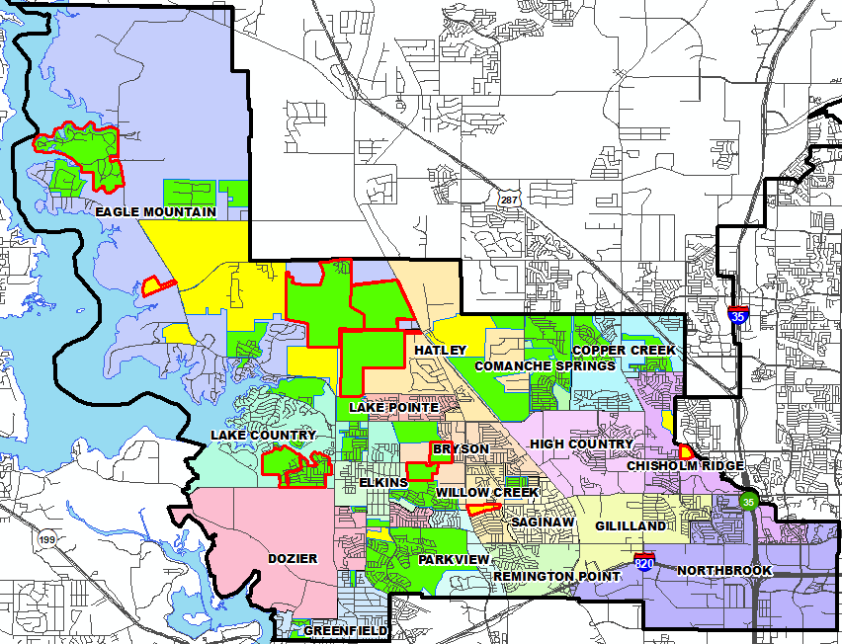
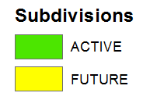
District Housing Overview
The District has 32 actively building subdivisions
Within EMSISD there are 19 future subdivisions
Ground-work is currently underway on approx. 1,342 lots in 11 separate subdivisions
475 lots were delivered in the 1st quarter

Slide 9
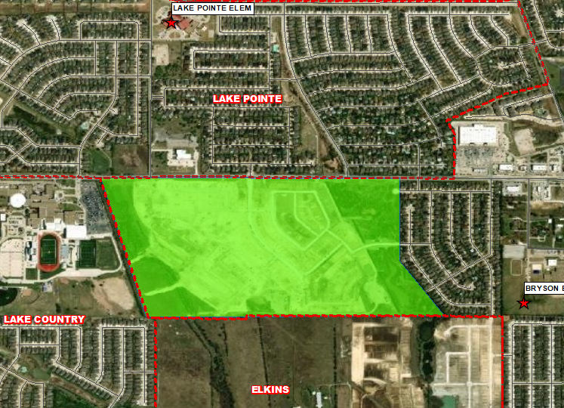
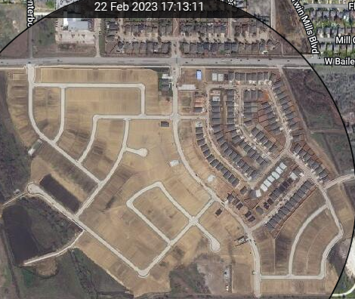
Residential Activity
Bailey Park
465 total homes
317 vacant developed lots
118 homes under construction
28 finished vacant homes/2 models
DR Horton community priced from the $320’s

Slide 10
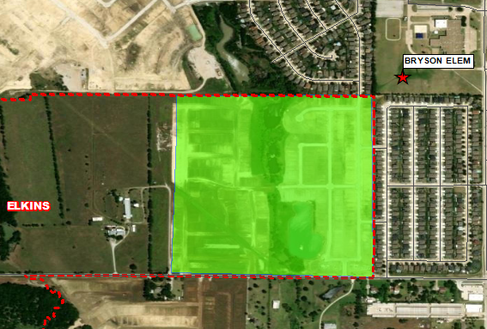
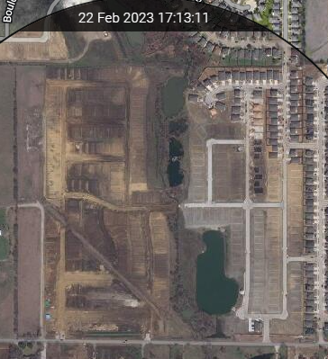
Residential Activity
Ranch at Duck Creek
365 total homes
111 vacant developed lots
55 homes under construction
194 futures
Starlight Homes rental community priced from $1,684/month

Slide 11
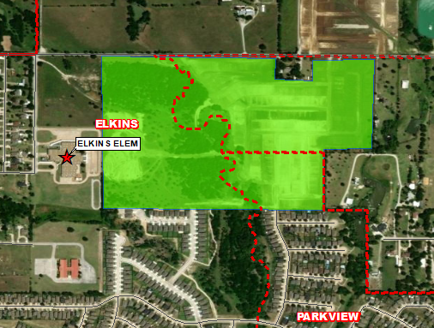
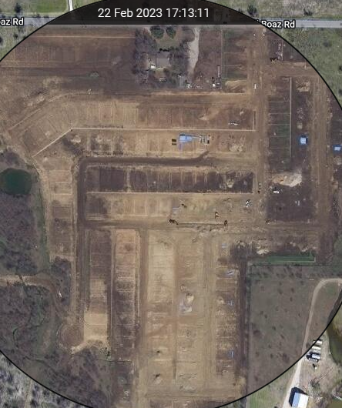
Residential Activity
Landing at Creekside
315 total homes
~150 vacant developed lots
~165 futures
Subdivision split into 3 different elem. zones: Elkins, Bryson, and Parkview

Slide 12
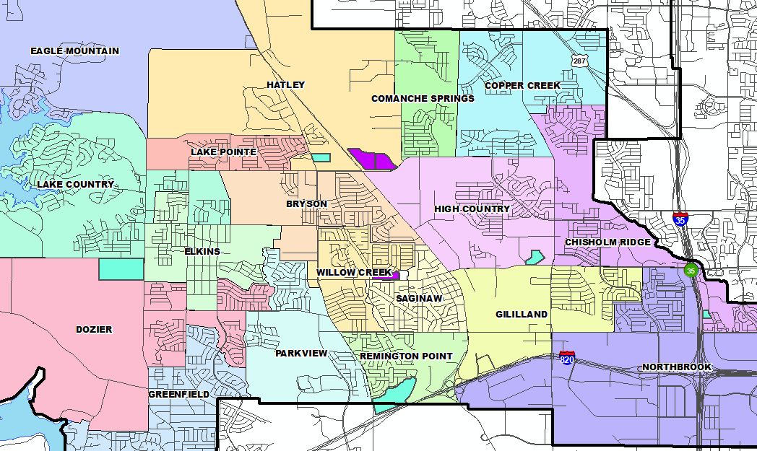
District Multi-Family Overview
Within EMSISD, there are five multi-family projects in the planning stages that contain approx. 1,700 future units
There are approx. 600 multi-family units currently under construction within the District in three separate projects, though one is a 120 unit senior living community (no impact)
Multi-Family Developments
MF Under construction
Future Multi-Family

Slide 13
Ten Year Forecast by Grade Level
 | EE | PK | K | 1st | 2nd | 3rd | 4th | 5th | 6th | 7th | 8th | 9th | 10th | 11th | 12th | Total | Total Growth | Total %
2018/19 | 114 | 413 | 1,484 | 1,535 | 1,495 | 1,516 | 1,596 | 1,773 | 1,645 | 1,597 | 1,546 | 1,621 | 1,632 | 1,491 | 1,311 | 20,769
2019/20 | 116 | 398 | 1,413 | 1,465 | 1,464 | 1,454 | 1,490 | 1,601 | 1,742 | 1,776 | 1,671 | 1,777 | 1,655 | 1,591 | 1,415 | 21,028 | 259 | 1.25%
2020/21 | 119 | 342 | 1,358 | 1,462 | 1,522 | 1,497 | 1,493 | 1,566 | 1,637 | 1,809 | 1,778 | 1,817 | 1,749 | 1,619 | 1,479 | 21,247 | 219 | 1.04%
2021/22 | 52 | 562 | 1,509 | 1,548 | 1,595 | 1,621 | 1,566 | 1,592 | 1,686 | 1,762 | 1,867 | 2,089 | 1,836 | 1,653 | 1,448 | 22,386 | 1,139 | 5.36%
2022/23 | 65 | 634 | 1,457 | 1,634 | 1,636 | 1,664 | 1,710 | 1,611 | 1,705 | 1,757 | 1,827 | 2,178 | 1,962 | 1,697 | 1,556 | 23,093 | 707 | 3.16%
2023/24 | 64 | 665 | 1,514 | 1,612 | 1,705 | 1,714 | 1,740 | 1,789 | 1,726 | 1,792 | 1,827 | 2,004 | 2,165 | 1,874 | 1,573 | 23,763 | 670 | 2.90%
2024/25 | 64 | 678 | 1,587 | 1,652 | 1,674 | 1,797 | 1,803 | 1,824 | 1,918 | 1,830 | 1,886 | 2,014 | 1,991 | 2,074 | 1,732 | 24,523 | 760 | 3.20%
2025/26 | 65 | 683 | 1,652 | 1,749 | 1,709 | 1,758 | 1,855 | 1,876 | 1,968 | 2,015 | 1,892 | 2,095 | 2,001 | 1,904 | 1,914 | 25,136 | 613 | 2.50%
2026/27 | 66 | 691 | 1,722 | 1,818 | 1,814 | 1,805 | 1,843 | 1,937 | 2,006 | 2,062 | 2,076 | 2,100 | 2,073 | 1,915 | 1,758 | 25,686 | 550 | 2.19%
2027/28 | 67 | 699 | 1,781 | 1,892 | 1,883 | 1,916 | 1,885 | 1,926 | 2,050 | 2,102 | 2,115 | 2,299 | 2,083 | 1,985 | 1,768 | 26,451 | 765 | 2.98%
2028/29 | 65 | 684 | 1,830 | 1,950 | 1,948 | 1,974 | 1,997 | 1,973 | 2,038 | 2,156 | 2,147 | 2,309 | 2,251 | 1,993 | 1,834 | 27,150 | 699 | 2.64%
2029/30 | 67 | 699 | 1,890 | 2,000 | 2,002 | 2,027 | 2,038 | 2,072 | 2,086 | 2,136 | 2,203 | 2,367 | 2,277 | 2,154 | 1,840 | 27,858 | 709 | 2.61%
2030/31 | 69 | 717 | 1,939 | 2,054 | 2,052 | 2,090 | 2,111 | 2,117 | 2,191 | 2,184 | 2,185 | 2,421 | 2,333 | 2,179 | 1,991 | 28,633 | 775 | 2.78%
2031/32 | 71 | 731 | 1,990 | 2,111 | 2,100 | 2,120 | 2,160 | 2,186 | 2,238 | 2,297 | 2,234 | 2,398 | 2,380 | 2,232 | 2,013 | 29,261 | 628 | 2.19%
2032/33 | 73 | 745 | 2,026 | 2,161 | 2,162 | 2,174 | 2,200 | 2,234 | 2,310 | 2,347 | 2,350 | 2,452 | 2,358 | 2,277 | 2,062 | 29,931 | 670 | 2.29%
Yellow box = largest grade per year
Green box = second largest grade per year

Slide 14
Ten Year Forecast by Elementary Campus
 |  |  | Fall | ENROLLMENT PROJECTIONS
Campus | Capacity | 2021/22 | 2022/23 | 2023/24 | 2024/25 | 2025/26 | 2026/27 | 2027/28 | 2028/29 | 2029/30 | 2030/31 | 2031/32 | 2032/33
HAFLEY DEVELOPMENT CENTER | 374 | 386 | 365 | 352 | 359 | 371 | 379 | 387 | 372 | 388 | 408 | 424 | 440
BRYSON ELEMENTARY | 736 | 568 | 548 | 463 | 465 | 490 | 508 | 533 | 568 | 590 | 604 | 610 | 613
CHISHOLM RIDGE ELEMENTARY | 803 | 664 | 720 | 712 | 702 | 700 | 695 | 675 | 685 | 698 | 701 | 715 | 725
COMANCHE SPRINGS ELEMENTARY | 781 | 550 | 553 | 538 | 584 | 592 | 608 | 623 | 650 | 652 | 663 | 660 | 653
COPPER CREEK ELEMENTARY | 803 | 565 | 648 | 715 | 725 | 720 | 758 | 761 | 744 | 745 | 737 | 737 | 742
DOZIER ELEMENTARY | 803 | 663 | 725 | 731 | 741 | 762 | 758 | 767 | 770 | 781 | 777 | 765 | 763
EAGLE MOUNTAIN ELEMENTARY | 758 | 431 | 501 | 529 | 587 | 658 | 751 | 922 | 1,081 | 1,223 | 1,389 | 1,560 | 1,751
ELKINS ELEMENTARY | 736 | 581 | 646 | 668 | 659 | 651 | 638 | 620 | 611 | 608 | 611 | 616 | 620
GILILLAND ELMENTARY | 691 | 501 | 481 | 491 | 501 | 518 | 530 | 532 | 523 | 518 | 513 | 507 | 502
GREENFIELD ELEMENTARY | 803 | 701 | 689 | 680 | 681 | 677 | 675 | 676 | 693 | 715 | 736 | 757 | 776
HATLEY ELEMENTARY | 803 | 0 | 0 | 228 | 285 | 358 | 431 | 511 | 588 | 646 | 721 | 788 | 855
HIGH COUNTRY ELEMENTARY | 758 | 556 | 567 | 593 | 623 | 635 | 628 | 623 | 626 | 641 | 652 | 659 | 654
LAKE COUNTRY ELEMENTARY | 803 | 686 | 671 | 661 | 683 | 691 | 725 | 764 | 822 | 876 | 890 | 906 | 913
LAKE POINTE ELEMENTARY | 781 | 585 | 660 | 691 | 690 | 693 | 712 | 730 | 735 | 745 | 743 | 745 | 741
NORTHBROOK ELEMENTARY | 781 | 551 | 571 | 609 | 605 | 614 | 627 | 612 | 609 | 602 | 607 | 606 | 609
PARKVIEW ELEMENTARY | 781 | 561 | 554 | 580 | 602 | 626 | 665 | 693 | 718 | 730 | 750 | 756 | 754
REMINGTON POINT ELEMENTARY | 758 | 557 | 551 | 558 | 557 | 559 | 588 | 622 | 621 | 626 | 629 | 625 | 622
SAGINAW ELEMENTARY | 558 | 341 | 327 | 326 | 326 | 312 | 310 | 293 | 300 | 307 | 311 | 313 | 316
WILLOW CREEK ELEMENTARY | 870 | 598 | 634 | 677 | 703 | 719 | 710 | 705 | 706 | 705 | 708 | 721 | 727
ELEMENTARY TOTALS | 14,181 | 10,045 | 10,411 | 10,802 | 11,078 | 11,347 | 11,696 | 12,049 | 12,422 | 12,795 | 13,149 | 13,469 | 13,775
Elementary Percent Change |  | 7.35% | 3.64% | 3.76% | 2.56% | 2.42% | 3.08% | 3.02% | 3.10% | 3.01% | 2.77% | 2.43% | 2.27%
Elementary Absolute Change |  | 688 | 366 | 391 | 276 | 269 | 349 | 353 | 373 | 374 | 354 | 320 | 306

Slide 15
Ten Year Forecast by Secondary Campus
 |  |  | Fall | ENROLLMENT PROJECTIONS
Campus | Capacity | 2021/22 | 2022/23 | 2023/24 | 2024/25 | 2025/26 | 2026/27 | 2027/28 | 2028/29 | 2029/30 | 2030/31 | 2031/32 | 2032/33
CREEKVIEW MIDDLE SCHOOL | 1,078 | 833 | 846 | 879 | 940 | 958 | 969 | 944 | 900 | 862 | 850 | 863 | 882
HIGHLAND MIDDLE SCHOOL | 1,050 | 758 | 731 | 753 | 817 | 838 | 868 | 924 | 940 | 913 | 873 | 866 | 892
PRAIRIE VISTA MIDDLE SCHOOL | 1,002 | 894 | 920 | 887 | 960 | 1,035 | 1,116 | 1,158 | 1,189 | 1,277 | 1,294 | 1,314 | 1,336
WAYSIDE MIDDLE SCHOOL | 1,002 | 1,057 | 1,079 | 1,108 | 1,109 | 1,164 | 1,235 | 1,259 | 1,320 | 1,392 | 1,550 | 1,682 | 1,804
WILLKIE MIDDLE SCHOOL | 1,002 | 703 | 722 | 763 | 786 | 837 | 864 | 898 | 900 | 870 | 874 | 904 | 937
MARINE CREEK MIDDLE SCHOOL | 1,200 | 1,058 | 982 | 946 | 1,013 | 1,034 | 1,083 | 1,075 | 1,083 | 1,102 | 1,110 | 1,131 | 1,147
MIDDLE SCHOOL TOTALS | 6,334 | 5,303 | 5,280 | 5,336 | 5,625 | 5,866 | 6,135 | 6,258 | 6,332 | 6,416 | 6,551 | 6,760 | 6,998
Middle School Percent Change |  | 1.59% | -0.43% | 1.06% | 5.42% | 4.28% | 4.59% | 2.00% | 1.18% | 1.33% | 2.10% | 3.19% | 3.52%
Middle School Absolute Change |  | 83 | -23 | 56 | 289 | 241 | 269 | 123 | 74 | 84 | 135 | 209 | 238
BOSWELL HIGH SCHOOL | 2,500 | 2,389 | 2,551 | 2,651 | 2,830 | 2,913 | 2,943 | 3,044 | 3,054 | 3,148 | 3,171 | 3,184 | 3,269
SAGINAW HIGH SCHOOL | 2,500 | 2,158 | 2,182 | 2,270 | 2,258 | 2,288 | 2,270 | 2,398 | 2,575 | 2,648 | 2,841 | 2,905 | 2,940
CHISHOLM TRAIL HIGH SCHOOL | 2,500 | 2,339 | 2,499 | 2,534 | 2,562 | 2,552 | 2,472 | 2,532 | 2,597 | 2,681 | 2,751 | 2,773 | 2,779
WATSON HIGH SCHOOL |  | 108 | 97 | 97 | 97 | 97 | 97 | 97 | 97 | 97 | 97 | 97 | 97
HIGH SCHOOL TOTALS | 7,500 | 6,994 | 7,329 | 7,552 | 7,747 | 7,850 | 7,782 | 8,071 | 8,323 | 8,574 | 8,860 | 8,959 | 9,085
High School Percent Change |  | 5.24% | 4.79% | 3.04% | 2.58% | 1.33% | -0.87% | 3.71% | 3.12% | 3.02% | 3.34% | 1.12% | 1.41%
High School Absolute Change |  | 348 | 335 | 223 | 195 | 103 | -68 | 289 | 252 | 251 | 286 | 99 | 126
TARRANT COUNTY JJAEP |  | 0 | 0 | 0 | 0 | 0 | 0 | 0 | 0 | 0 | 0 | 0 | 0
ALTERNATIVE DISCIPLINE SCHOOL |  | 44 | 73 | 73 | 73 | 73 | 73 | 73 | 73 | 73 | 73 | 73 | 73
ALTERNATIVE SCHOOL TOTALS |  | 44 | 73 | 73 | 73 | 73 | 73 | 73 | 73 | 73 | 73 | 73 | 73
DISTRICT TOTALS |  | 22,386 | 23,093 | 23,763 | 24,523 | 25,136 | 25,686 | 26,451 | 27,150 | 27,858 | 28,633 | 29,261 | 29,931
District Percent Change |  | 5.37% | 3.16% | 2.90% | 3.20% | 2.50% | 2.19% | 2.98% | 2.64% | 2.61% | 2.78% | 2.19% | 2.29%
District Absolute Change |  | 1,141 | 707 | 670 | 760 | 613 | 550 | 765 | 699 | 709 | 775 | 628 | 670

Slide 16
Key Takeaways
2022 new home starts within EMSISD were significantly higher, up ~35%, as supply chain issues were resolved and demand returned
The district currently has 32 actively building subdivisions with approx. 2,870 lots available to build on
EMSISD has 19 future subdivisions with nearly 17,000 lots in the planning stages
Groundwork is underway on nearly 1,350 lots within 11 subdivisions
Eagle Mountain-Saginaw ISD is forecasted to enroll approx. 26,450 students by 2027/28 and nearly 30,000 by 2032/33

